Slide 1
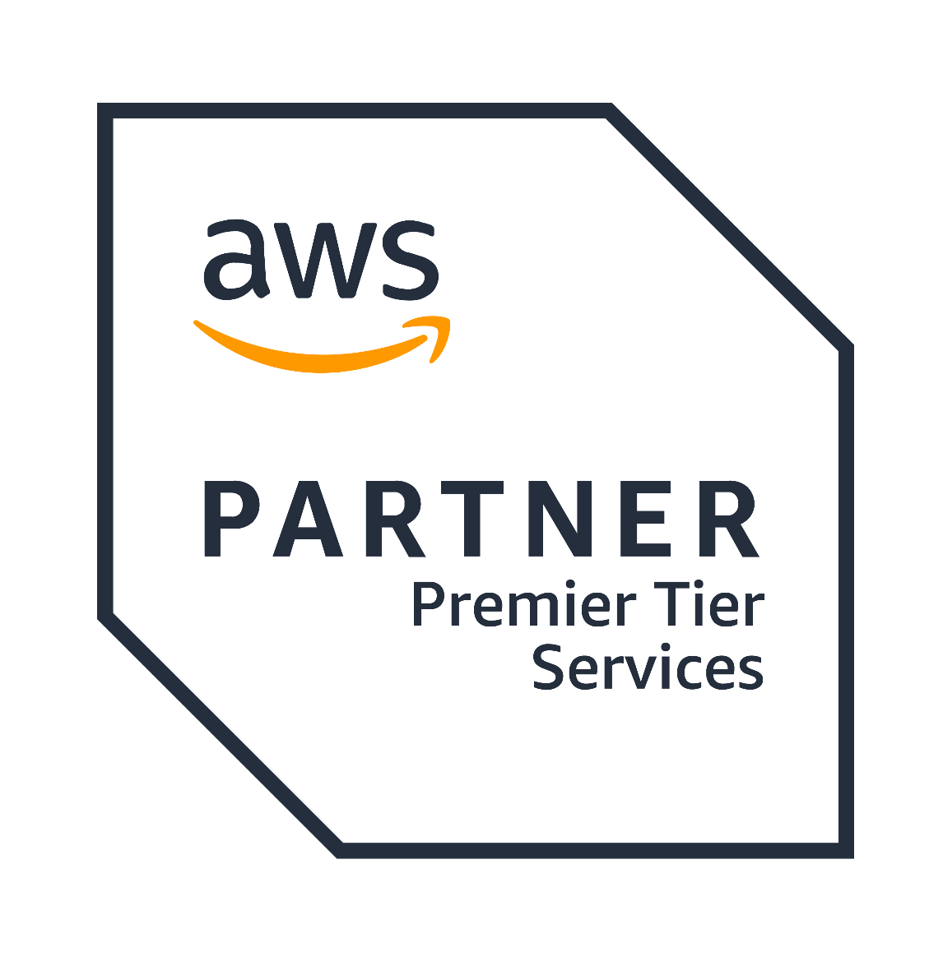








Proudly recognized by

Slide 2
Introduction to Spring Boot
Why Spring Boot?
MVC Architecture
Spring Initializer & Project Setup
Folder Structure & Naming Conventions
Application Properties & YAML
Core Annotations & Use Cases
Profiles & Environment Configurations
Restful Service
Spring AOP & Controllers
Live Demo & Q&A
Agenda

Slide 3
Introduction to spring boot
Spring Boot is an extension of the Spring framework that simplifies application development.
Reduces boilerplate code and configuration.
Embedded server support (Tomcat, Jetty, Undertow).
Production-ready features like monitoring, metrics, and health checks.
Convention over configuration

Slide 4
Understanding Convention Over Configuration
Embedded Servers
Convention: Spring Boot ships with an embedded Tomcat, Jetty, or Undertow server.
Configuration (if needed): You can override it in application.properties
Auto Configuration
Convention: Spring Boot automatically configures beans based on classpath dependencies.
Example: If spring-boot-starter-data-jpa is present, Spring Boot auto-configures Hibernate & a DataSource.
Configuration: You can override it in application.properties
server.port=8081
spring.datasource.url=jdbc:mysql://localhost:3306/mydb
spring.datasource.username=root
spring.datasource.password=pass

Slide 5
Why Spring Boot?
Auto Configuration: No need for complex XML configurations.
Microservices Friendly: Easily scalable and deployable.
Embedded Server: Runs without external server setup.
Spring Ecosystem Integration: Works well with Spring Security, JPA, Kafka, RabbitMQ, etc.
Actuator & Monitoring: Provides built-in monitoring endpoints.

Slide 6
MVC Architecture
Model-View-Controller (MVC) Pattern
Model: Represents business logic & data (e.g., Service Layer, DTOs, Entities).
View: Handles UI representation (not covered in backend API design).
Controller: Handles user requests and delegates logic to the service layer.

Slide 7
Spring Boot MVC Flow
Spring Boot MVC Flow
Client Request: A client (browser, mobile app, or API client) sends an HTTP request.
Request passes through Filters.
The request first reaches Spring’s DispatcherServlet, which acts as a front controller.
The DispatcherServlet consults the HandlerMapping to determine the appropriate Controller.
The request is passed to the corresponding Controller method.
The Controller may call a Service Layer method for business logic.
The Service Layer may interact with the Repository/DAO to fetch/update data from the database.
The Controller returns a View (Thymeleaf, JSP) or JSON (REST API).
If it’s a web app, the ViewResolver resolves the correct view template.
The response is sent back to the client.

Slide 8
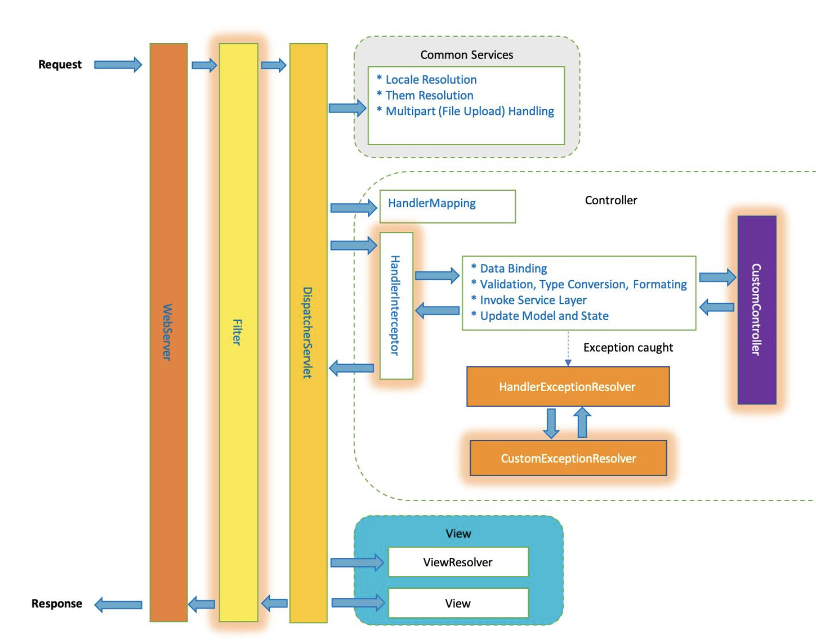
Spring Boot MVC Flow

Slide 9
Spring Initializer & Project Setup
Use Spring Initializer to generate a boilerplate project.
Select dependencies:
Spring Web (for REST API development)
Spring Boot Actuator (for monitoring)
Spring Data JPA (for database operations)
Spring Security (for authentication and authorization)
Spring AOP (for aspect-oriented programming)
Build Tool: Gradle
./gradlew bootRun

Slide 10
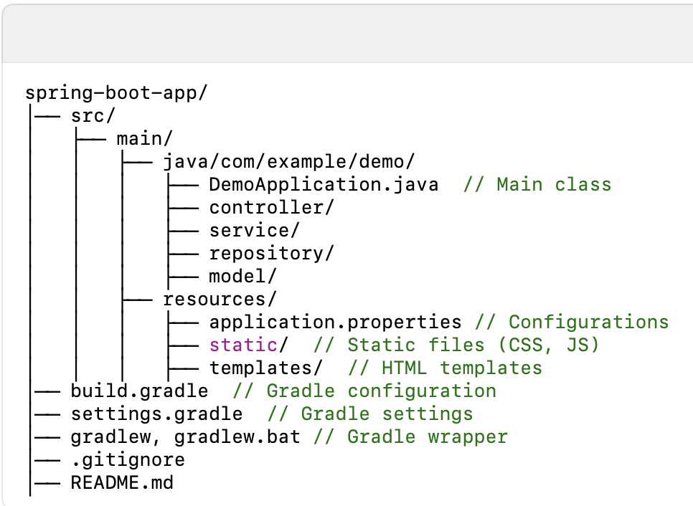
Spring Boot Folder Structure

Slide 11
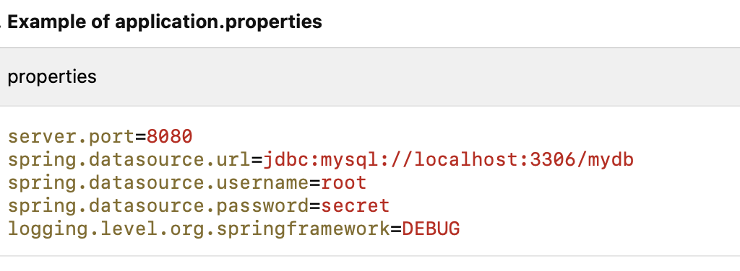
Application.properties Vs Application.Yaml
1. Configuration Formats
Spring Boot supports two formats for configuration:
• application.properties (Key-Value Format)
• application.yml (Hierarchical Format)

Slide 12
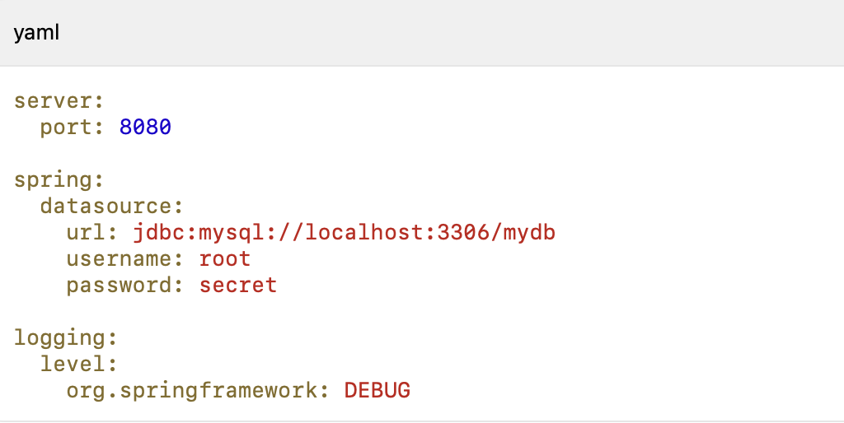
Application.properties Vs Application.Yaml

Slide 13
Spring Boot Annotation Overview
Why Use Annotations?
Annotations in Spring Boot simplify configuration and enable powerful features like dependency injection, web services, and database integration.
Core Annotations Categories
1. Application-Level (e.g., @SpringBootApplication)
2. Component Scanning & Dependency Injection (e.g., @Component, @Service, @Repository)
3. Web & REST API (e.g., @RestController, @RequestMapping, @GetMapping)
4. Configuration & Profiles (e.g., @Configuration, @Profile)

Slide 14
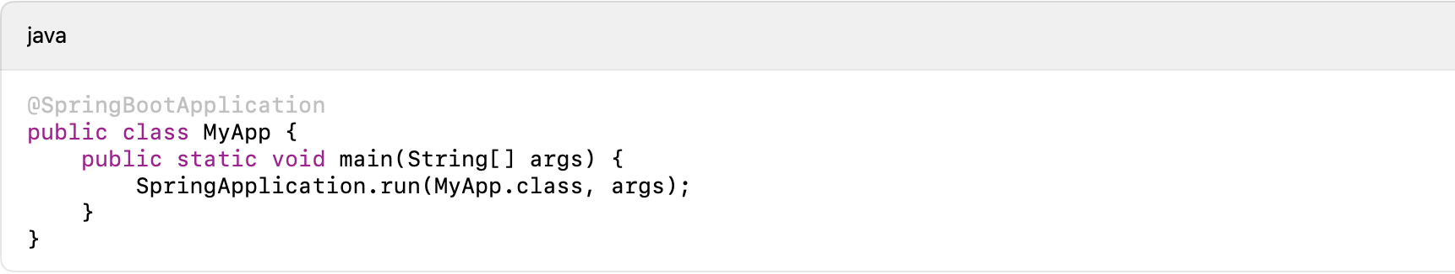
Application Level Annotation
1. @SpringBootApplication
• Entry point of a Spring Boot application.
• Combines @Configuration, @EnableAutoConfiguration, and @ComponentScan.
• Example:

Slide 15
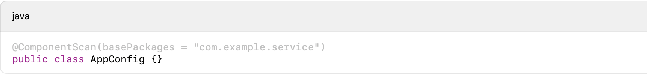
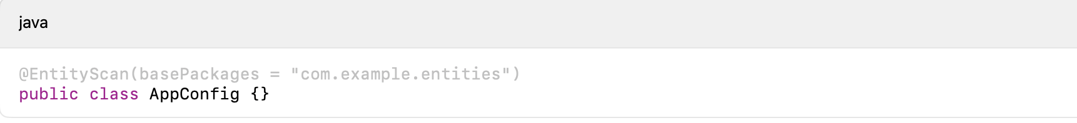
Annotation Continue….
@ComponentScan
• Scans specified packages for Spring-managed beans (@Component, @Service, @Repository).
@EntityScan
• Scans specified packages for JPA entity classes.

Slide 16
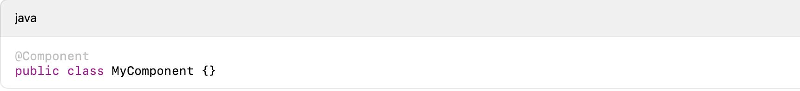
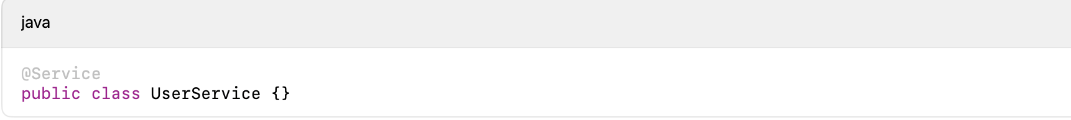
Component & Dependency Injection
@Component
• Marks a generic Spring-managed bean.
@Service
• Specialized @Component used for service layer logic.

Slide 17
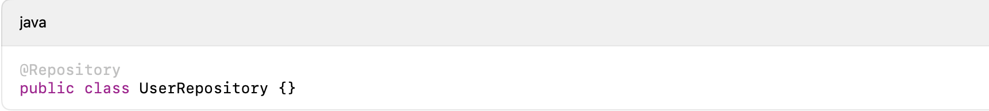
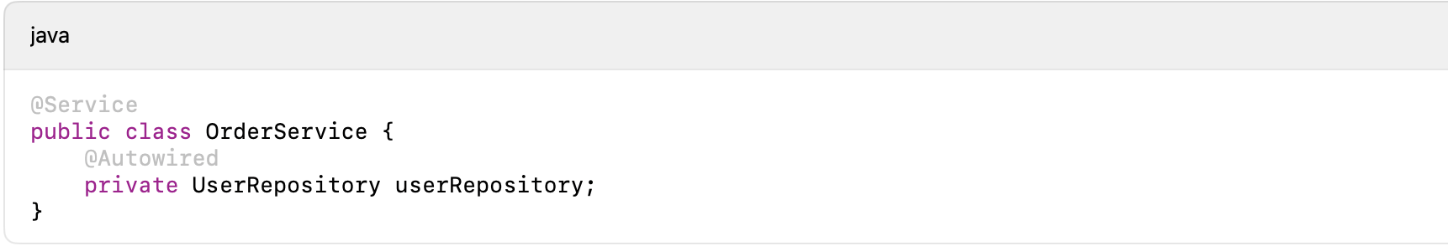
Annotation Continue…
@Repository
• Specialized @Component used for DAO (Data Access Object) pattern.
@Autowired
• Injects dependencies automatically.

Slide 18
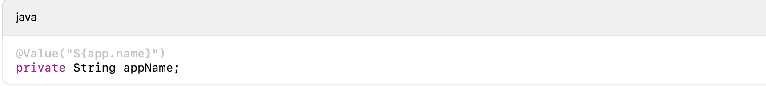
Annotation Continue
@Value
• Injects values from application.properties or application.yml.

Slide 19
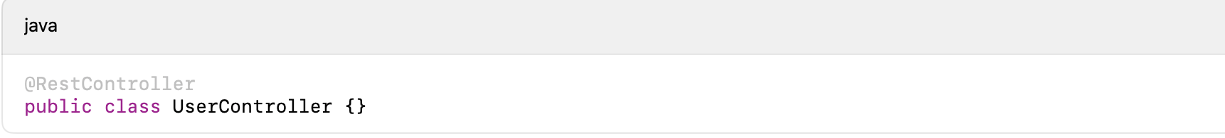
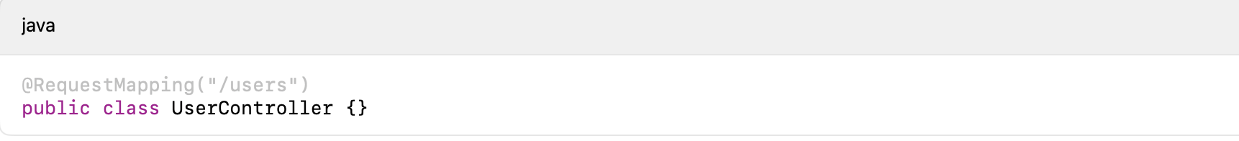
Web & Rest API Annotation
@RestController
• Combines @Controller and @ResponseBody to create RESTful APIs.
@RequestMapping
• Maps HTTP requests to a controller method.

Slide 20
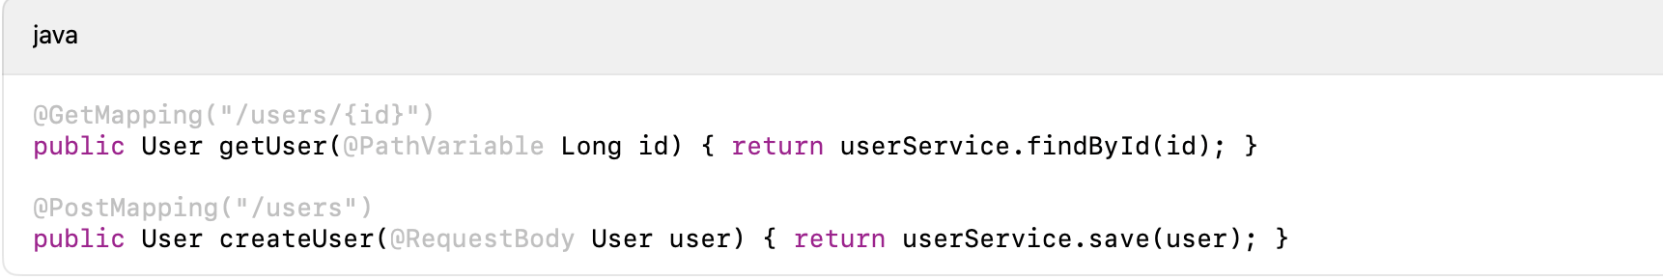
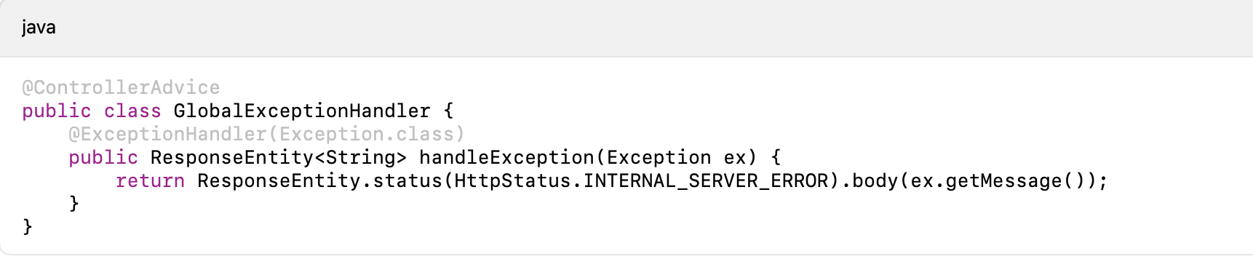
Annotation Continue
@GetMapping & @PostMapping
• Shortcut for @RequestMapping with GET or POST methods.
@ControllerAdvice
• Global exception handling for controllers.

Slide 21
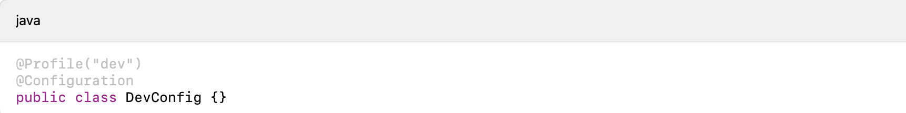
Annotation Continue
@Profile
• Activates beans for a specific environment.

Slide 22
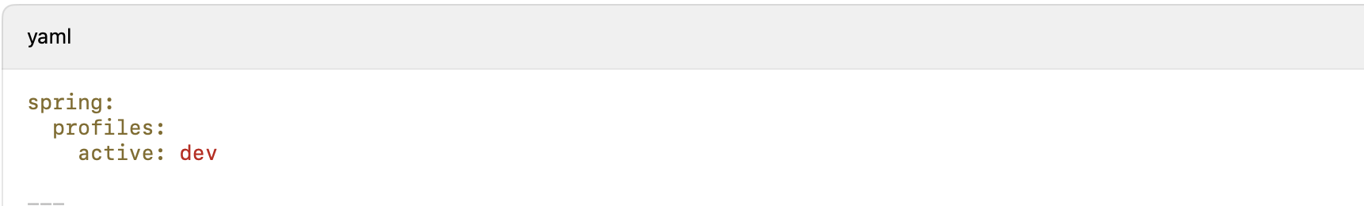
Profiles & Environment Configurations
Switch Between Environments
Use spring.profiles.active=dev to activate a specific profile.
./gradlew bootRun -Dspring.profiles.active=qa

Slide 23
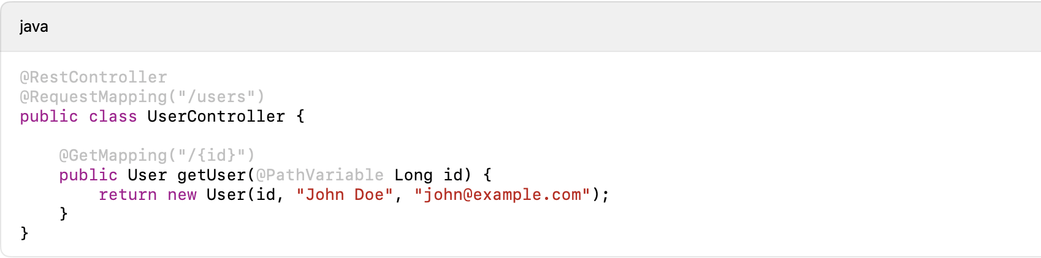
Restful Services
What are RESTful Services?
RESTful services are web services that follow the REST (Representational State Transfer) architectural style, enabling communication between client and server using HTTP.
Key Characteristics:
• Stateless: Each request is independent; the server does not store client state.
• Client-Server Architecture: The client and server communicate over HTTP.
• Resource-Based: Everything is treated as a resource (e.g., Users, Orders).
• Uses Standard HTTP Methods: GET, POST, PUT, PATCH, DELETE.
• Supports Multiple Data Formats: JSON (commonly used), XML, etc.

Slide 24
Http Methods
• GET: Retrieves data from the server (Read-only, idempotent).
• POST: Creates a new resource (Not idempotent, has a request body).
• PUT: Updates or replaces an existing resource (Idempotent, has a request body).
• PATCH: Partially updates an existing resource (Not idempotent, has a request body).
• DELETE: Removes a resource from the server (Idempotent, no request body).
• HEAD: Similar to GET but returns only headers, no response body.
• OPTIONS: Returns allowed HTTP methods for a resource.

Slide 25
Spring AOP
Aspect-Oriented Programming (AOP) is a programming paradigm that separates cross-cutting concerns (e.g., logging, security, transactions) from business logic.
Helps in achieving cleaner, modular, and maintainable code.

Slide 26
Key Point
Key Concepts in AOP:
Aspect: A modularization of cross-cutting concerns (e.g., LoggingAspect).
Advice: The action taken by an aspect (Before, After, Around, etc.).
Pointcut: Defines where an advice should be applied.
Join Point: A point in execution where advice can be applied.
Weaving: Linking aspects with the application.

Slide 27
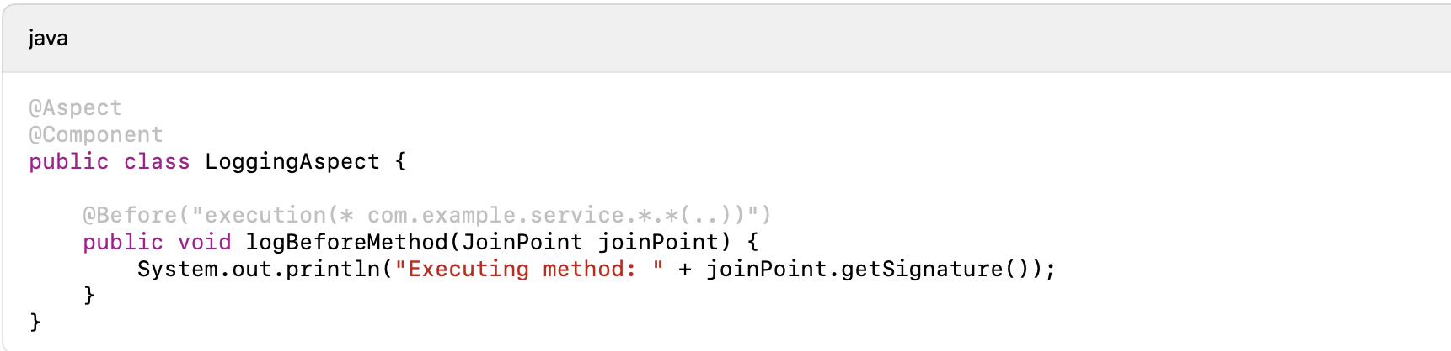
Types of Advice
@Before: Runs before the method execution
@After: Runs after method execution (regardless of success or failure)
@AfterReturning: Runs after method execution only if it succeeds
@AfterThrowing: Runs if a method throws an exception
@Around: Runs before and after method execution (powerful, allows modifications)

Slide 28
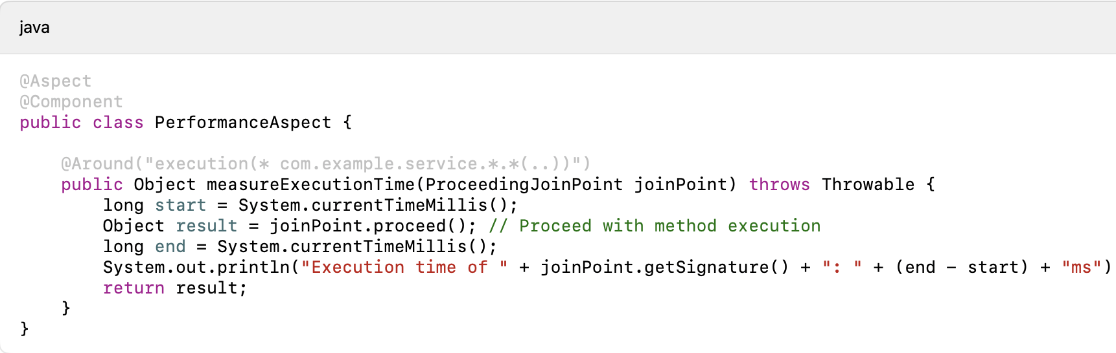
Defining pointcut and applying advices
Pointcut Expressions
• Defines which methods should be intercepted using AspectJ expressions.
• Example patterns:
• execution(* com.example.service.*.*(..)) → Matches all methods in service package.
• within(com.example.service..*) → Matches all classes in service package.
• @annotation(org.springframework.transaction.annotation.Transactional) → Matches methods with @Transactional.

Slide 29
Why use AOP?
✔️Reduces boilerplate code for common concerns like logging, security, and transactions.
✔️ Improves code reusability by keeping cross-cutting concerns separate.
✔️ Enhances maintainability by centralizing repetitive logic.

Slide 30
Real world use case
✅ Logging – Automatically log method execution details.
✅ Security – Implement authentication & authorization checks.
✅ Performance Monitoring – Measure execution time of methods.
✅ Transaction Management – Automatically handle transactions.

Slide 31
Thank You

